Slide 1

E-Safety @ Monnow
Notes:
To change the wallpaper, right click on it and select “Replace image”.
In present mode, the home button on the slides will take you to slide 2, except for slide 2, that will take you to slide 1.

Slide 2

What is E-Safety?
E-Safety is all about keeping you safe while online.
This includes while gaming, using social media, messaging friends or accessing websites.
Games, social medias and some websites have age ratings which are in place to help keep you safe.
For example, Tik Tok has an age rating of 13+ because much of the content is inappropriate for children.
Notes:
Pause moment? Ask children if they use any social medias or play games that have an age rating that isn’t appropriate for them at the moment.

Slide 3
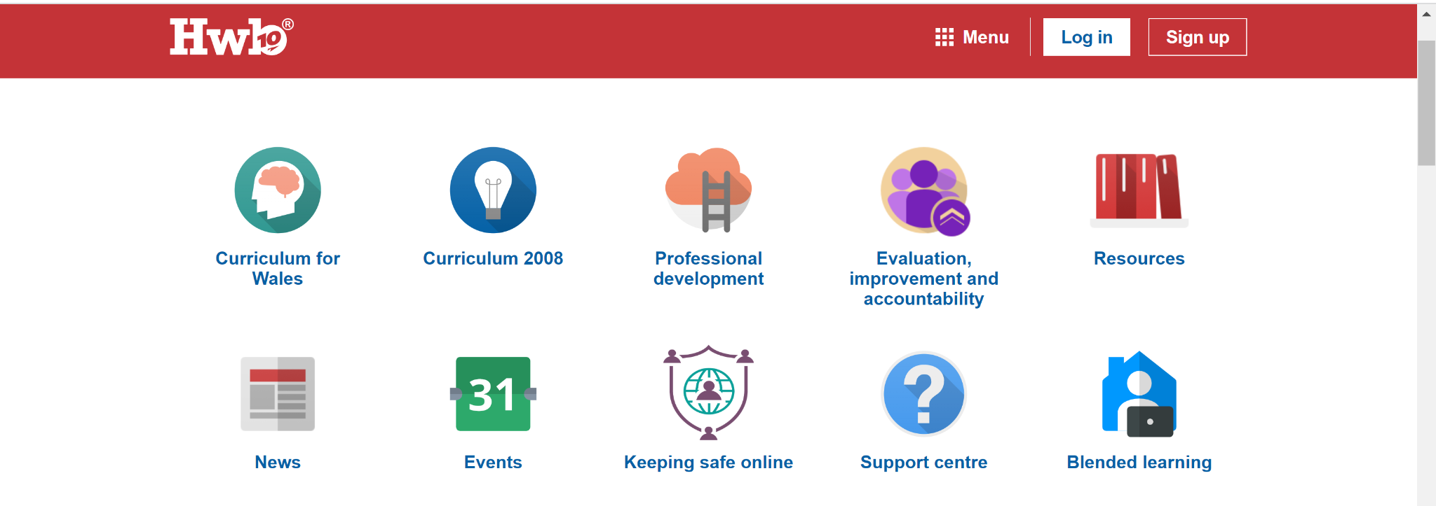
Where to find advice?
There are lots of great things about social media, apps and games, life wouldn't be the same without them for most of us. But sometimes things can go wrong and you might feel like you are in an unsafe or upsetting situation.
We all want to keep our online experience positive so this area has been created to help you make sense of some of the issues that you might have to deal with. The information pages also include advice on what to do and where to turn for help if you are worried about something online.
Always keep in mind that you have rights and these rights also apply in the digital world!
Notes:
Talk through the slide before pointing people toward the Keeping Safe Online part of hwb. Remind people that you don’t need a hwb account to be able to access this area of hwb.

Slide 4
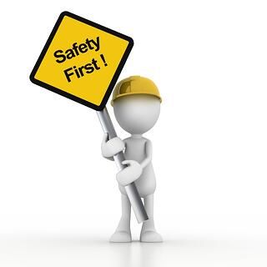
Keeping safe online
At Monnow we want to help you stay safe online by teaching you the importance of these values:
• Think critically and evaluate apps, websites and other digital content.
• Protect themselves from online threats, including bullying and scams.
• Get smart about sharing: what, when, how, and with whom.
• Be kind and respectful toward other people online, including respecting their privacy.
• Ask for help with tricky situations from a parent or other trusted adult.

Slide 5

Notes:
We have a short video to watch about the dangers of sharing inappropriately online.

Slide 6
E-Safety @ Monnow
Notes:
Thanks for listening, we hope you have learned something from our assembly and continue to be safe while online.

